Slide 1
Grid Modernization Docket
Cheryl A. Warren
National Grid
November 14, 2012

Slide 2
System Investment for our Customers

Slide 3

Start with the Customer and work backwards
http://www.nuritelecom.com/solutions/smart-grid.html

Slide 4
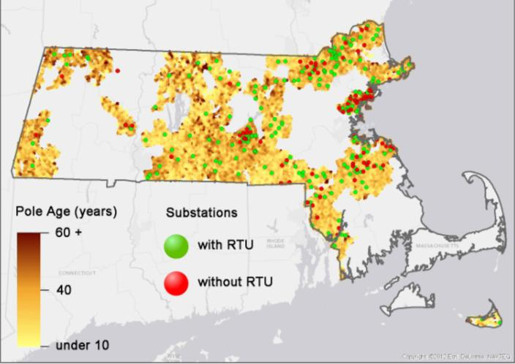
Massachusetts Electric System
1.2+M Customers
Over 18,000 manholes
Over 700,000 poles
Over 160 substation
1,100 Distribution feeders
Nearly 1,100 reclosers

Slide 5
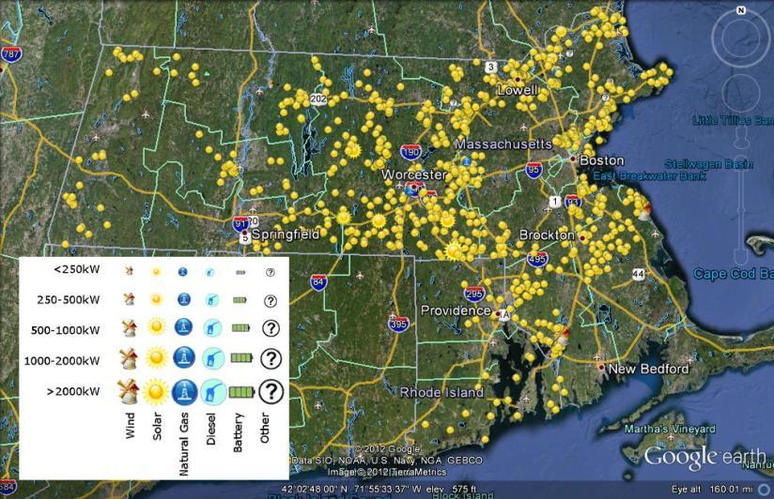
Distributed Generation –
In-Service

Slide 6
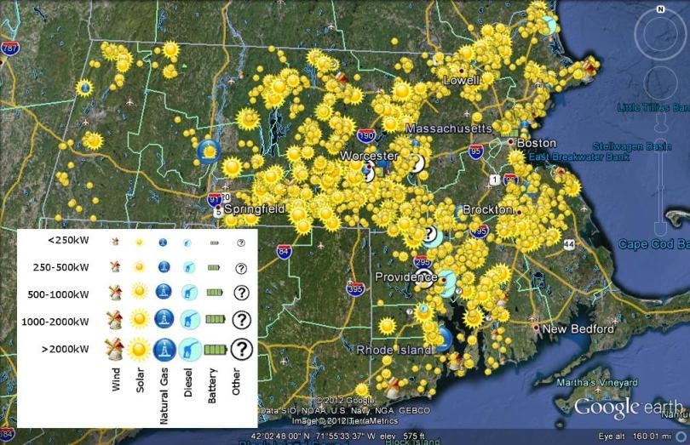
Distributed Generation –
In-Service + Proposed

Slide 7
Reliability Performance
Reliability Enhancement
Program

Slide 8
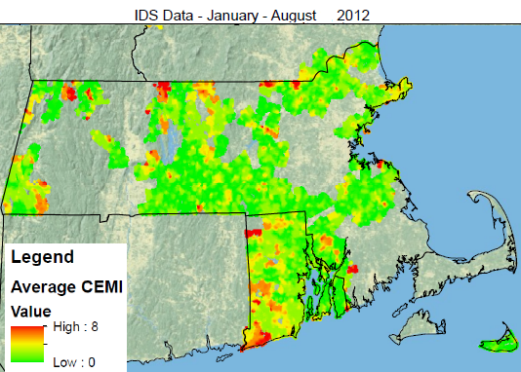
A Look at CEMI
Customers Experiencing
Multiple Interruptions

Slide 9
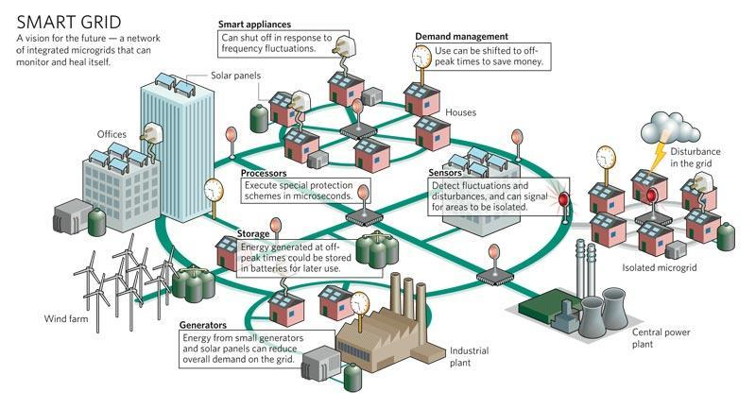
The Age of Convergence
Image © http://www.consumerenergyreport.com/smart-grid/

Slide 10
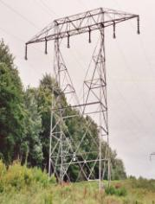
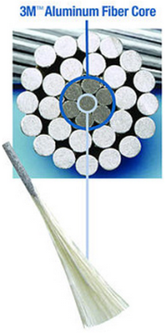


A-127/B-128 Refurbishment
A-127 / B-128:
  85+ years old, 67 circuit miles
  508 double circuit lattice structures with 4/0 Copper
Conceptual engineering process determined that the reconductoring of the two circuits with New 477 ACCR Composite Core provides the preferred least cost solution plus:
.
  Weighs less – better storm performance
  Allows more current to flow for future capacity issues
  Conductor Corrosion
  Shield wire Corrosion
Notes:
1) TPS = Transmission Performance Score; includes customer impacts (50%), system impact (25%), and benchmarking (25%).

Slide 11
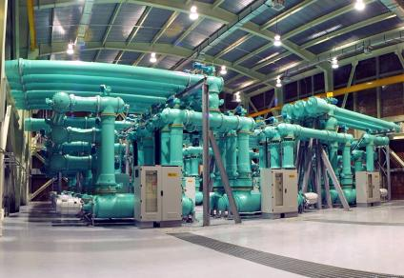
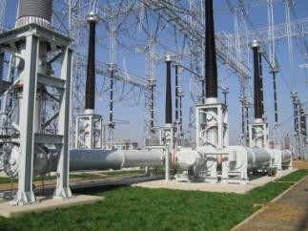
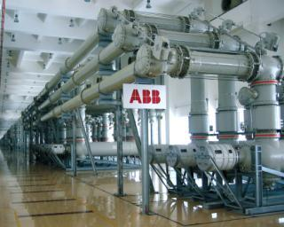
Rebuilding Transmission Substations
Brayton Point added GIS
Tewks 22A planning new GIS
Wakefield Junction new GIS - allowed retirement of Golden Hills GIS
Ward Hill rebuilt and added GIS
Wachusett rebuilt and added GIS
Gas Insulated Switchgear (GIS) substations reduces the clearance distances required (less space), are less sensitive to pollution, and have lower operation & maintaince cost.
Source: ABB website
11

Slide 12
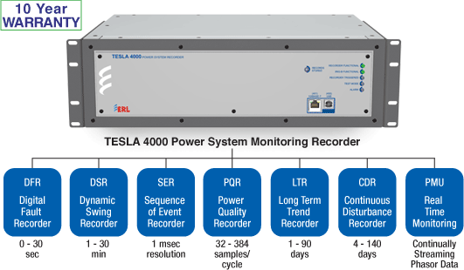
Smarter Transmission
14 PMUs at
7 Substations

Slide 13

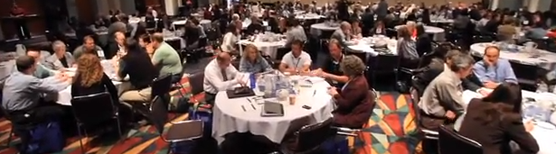
Worcester Green2Growth
Community Summit
“Appreciate Inquiry” approach – full-scale community plan, design, and implementation forum bringing a comprehensive system of internal and external stakeholders together in a concentrated way to work on a task of strategic importance.
Belief that every organization/person has positive aspects that can be built upon.
NG Hosted 2-Day AI Worcester event with customer/community/stakeholder collaboration sessions to “design a road map to transform Worcester into the innovative energy leader of a smarter Commonwealth.”
AI Summit served as a foundation for the Outreach & Education plan with customer “listen, test & learn” approach
Participants identified 15 opportunity areas including Smart Grid
Notes:
Customer engagement and partnership in the communities initiatives build common platform for programs
15 Areas
Area-aspect in O/E covering it
Key aspects 1. communication 2. Youth engagement 3. sustainability 4. supporting Worcester
1. Sustainability Center- sustainability hub and webinars sharing
2.Asset Roadmap / Green Monster Scoreboard / Awards- we will be frequently communicating accomplishments of the pilot through quarterly/monthly emails and bill inserts
3.Keep the dollars flowing into Worcester-We have partnered with Worcester to help support economic development by improving energy services to business through the Smart Grid Pilot
4. Video Challenge with students-we are will engage students k-12 with a variety of approaches and college students with a co-op program educating and engaging the youth and will partner with local college on helping the O/E plan
5. Green2Growth business network -We will be hosting several lunch learns to gather community members to network and engage/educate about the Smart Grid pilot
6.Job shadowing and training- college co-op program will help educate youths and leverage them in the pilot as front line support
7.Renewable project development forum- we will leverage internal resources to support distributed generation in Worcester
8. Achieving net zero- we will be working with the commonwealth of Massachusetts to comply with the Green communities Act and have support the cape wind project
9.Greening the heart of Worcester- supporting green initiatives with internal resources and providing green tips and installing sol engaging youth
10. “Worcester, come near to our heart”-engaging members of the community with lunch and learns and school visits to begin cultural shifts
11. Low-income leadership-we are offering bill protection to help lower the energy burden on LI
12.Greening the transportation of Worcester-we are installing EV charging stations in the pilot area
13. Green declaration of independence-Developed and added onto the green to growth website.
14. Worcester’s Sustainable Portfolio- partnering with local businesses to help support new green technologies
15.Keep the Momentum Going-continued outreach and education events through emails, bill inserts, IHDs, lunch and learns and other community events

Slide 14
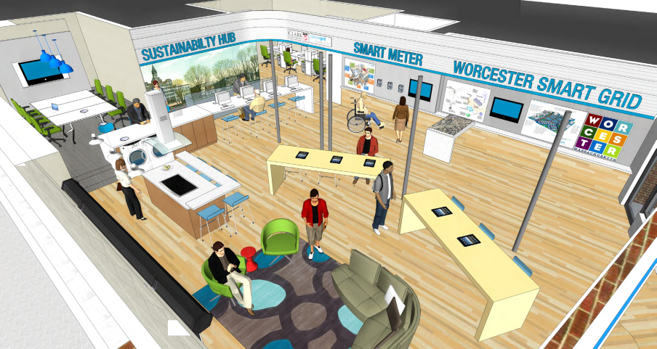
Customer – Sustainability Hub
Notes:
14
Walk through the slide then add the following points
The Sustainability Hub will offer easy to understand demonstrations of the smart grid technology much like the apple store does with it’s products
But it also serves as an outreach and education campaign headquarters, where we’ll house our college co-op interns and from where we’ll be planning and executing our community based outreach and education

Slide 15
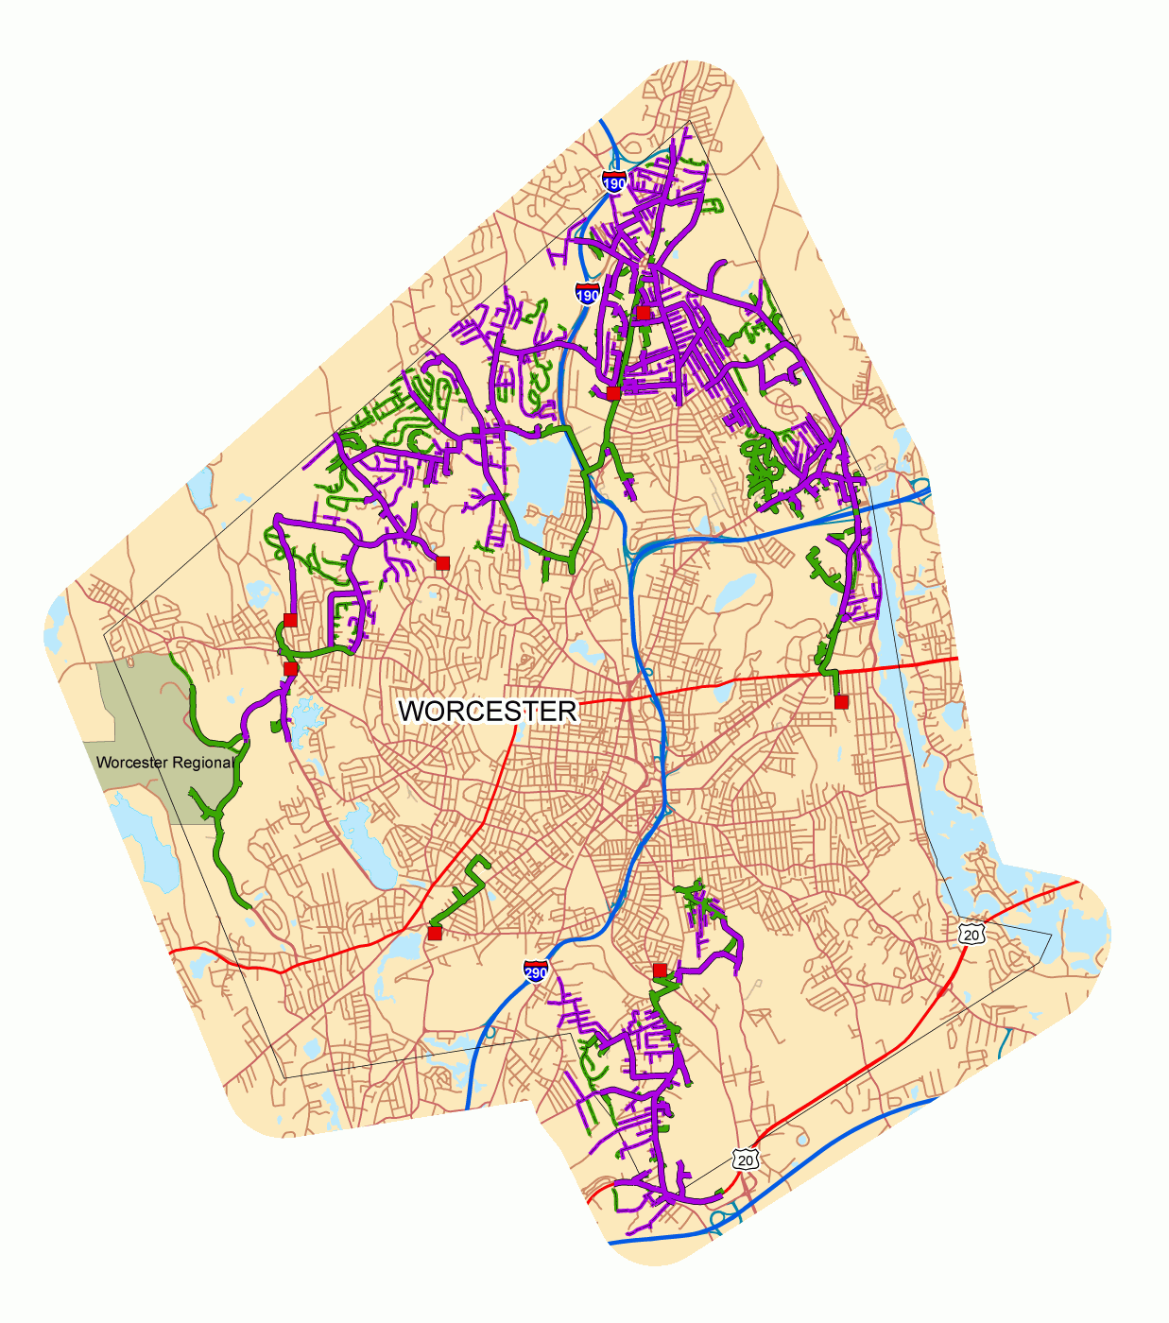
Smartgrid Pilot Worcester
Testing Grid Device and Deep Customer Engagement
15,000 Customers
  all customer segments
Grid Facing
  165 miles of electricity distribution lines
  5 substations and 11 feeders
  70 reclosers
  50 capacitor banks
  Monitoring and Fault Indication
Customer facing
  Smart Meters – new billing options
  Better and more detailed use data
  Home Energy Management
  Sustainability Hub
15
Notes:
Why Worcester
centrally located in Massachusetts
Diverse microcosm of the Commonwealth
Sample of customer population over a varied mix of customers
15,000 households and businesses
Diverse distribution system with both underground and overhead networks
Number of existing/potential distribution generation project sites
Institutions of higher learning

Slide 16
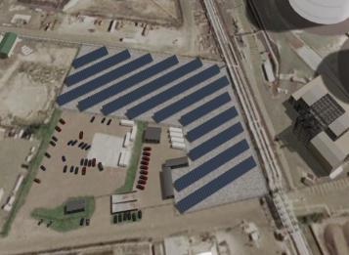
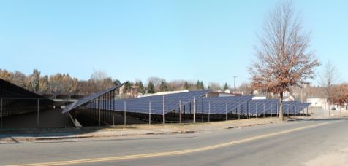
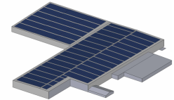
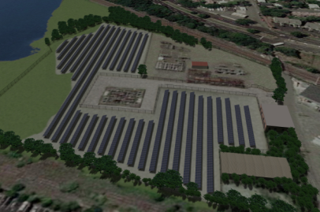
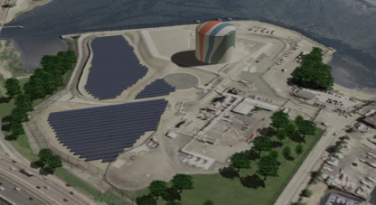
5 MW regulated Solar
EVERETT, MA
HAVERHILL, MA
SUTTON, MA
REVERE, MA
DORCHESTER, MA

Slide 17
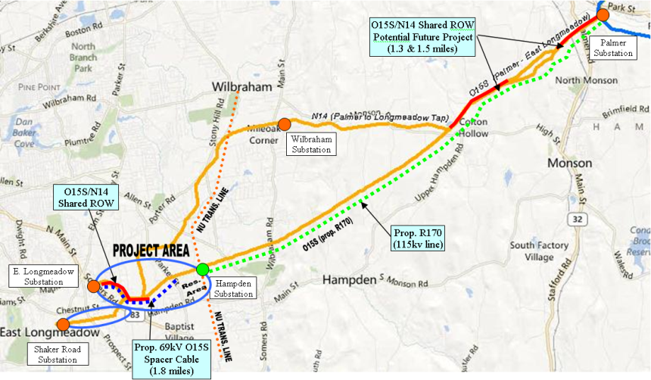
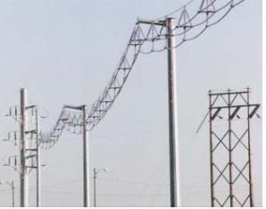
Addressing Customer needs 69 kV spacer cable
Spacer cable provides a solution to limitations on right-of-ways and also has the mechanical strength to weather severe storms and the electrical strength to prevent faults (phase to phase/phase to ground)

Slide 18
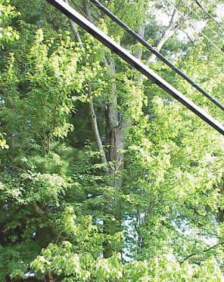
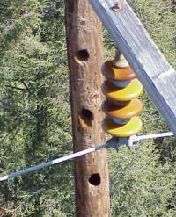
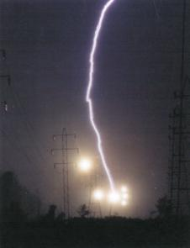
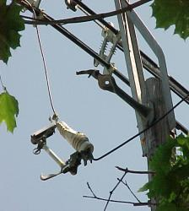
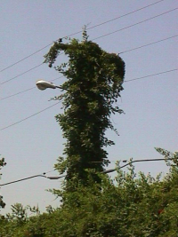
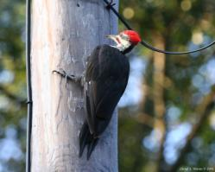
Reliability Enhancement Program
Targeted asset replacement with defined expected reliability improvement
Addition of over 300 reclosers
Enhanced Hazard Tree removal

Slide 19
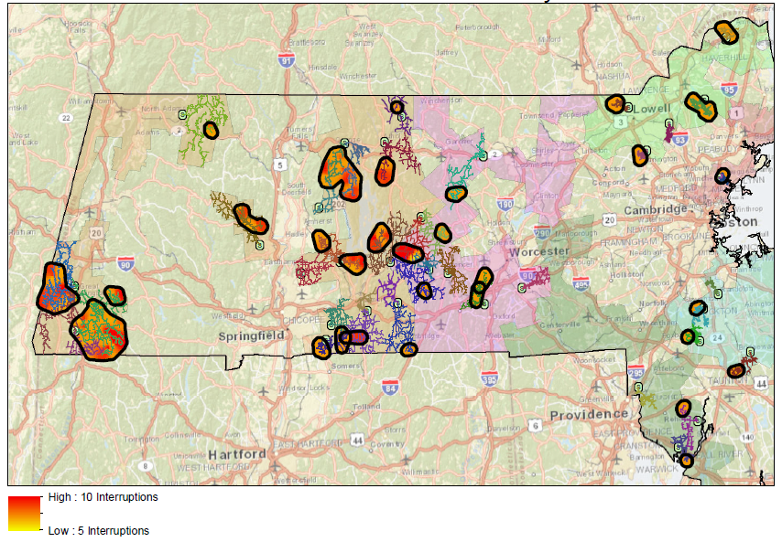
Minor Storm Hardening

Slide 20
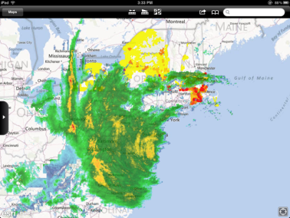
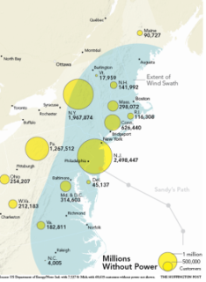
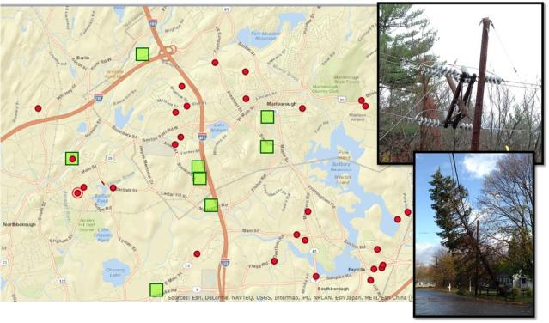
New technology provides better information

Slide 21
Questions for consideration
How fast do we modernize the whole grid?
  Is it a two year project or 40 year project or ???
What technologies deliver the biggest value for customers?
  How do we evaluate value?
Who pays for the modern grid and with what prices?
What is the lifespan of the modern grid before it is superseded by improved technology?
All of these questions must be evaluated with customers’ evolving expectations at the forefront of the discussion.

